Slide 1
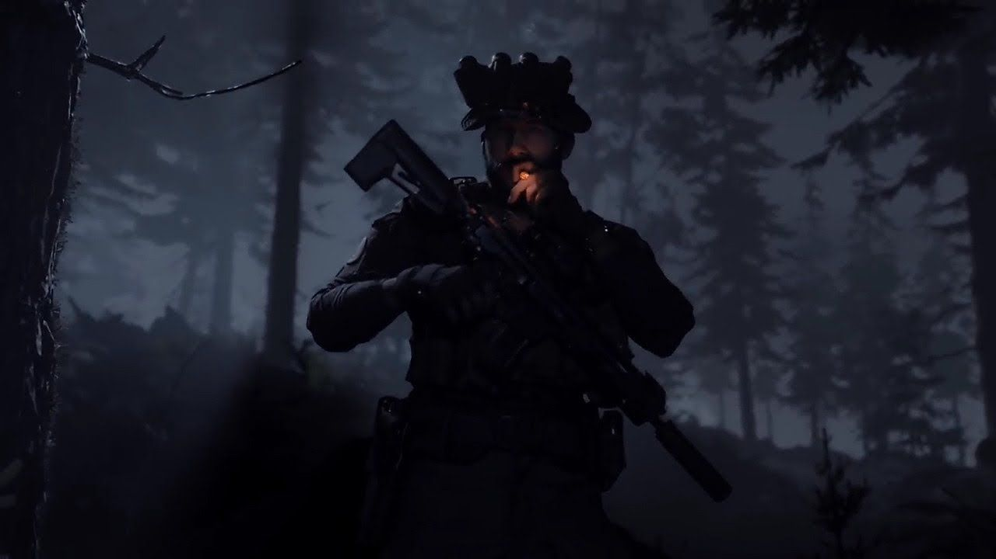

Text Mining
Text Mining
By Jack Daoud
By Jack Daoud

Slide 2



How can we increase CDL’s reach?

Slide 3
Outline
Data Overview
Text Mining
Process
Findings
Recommendations

Slide 4

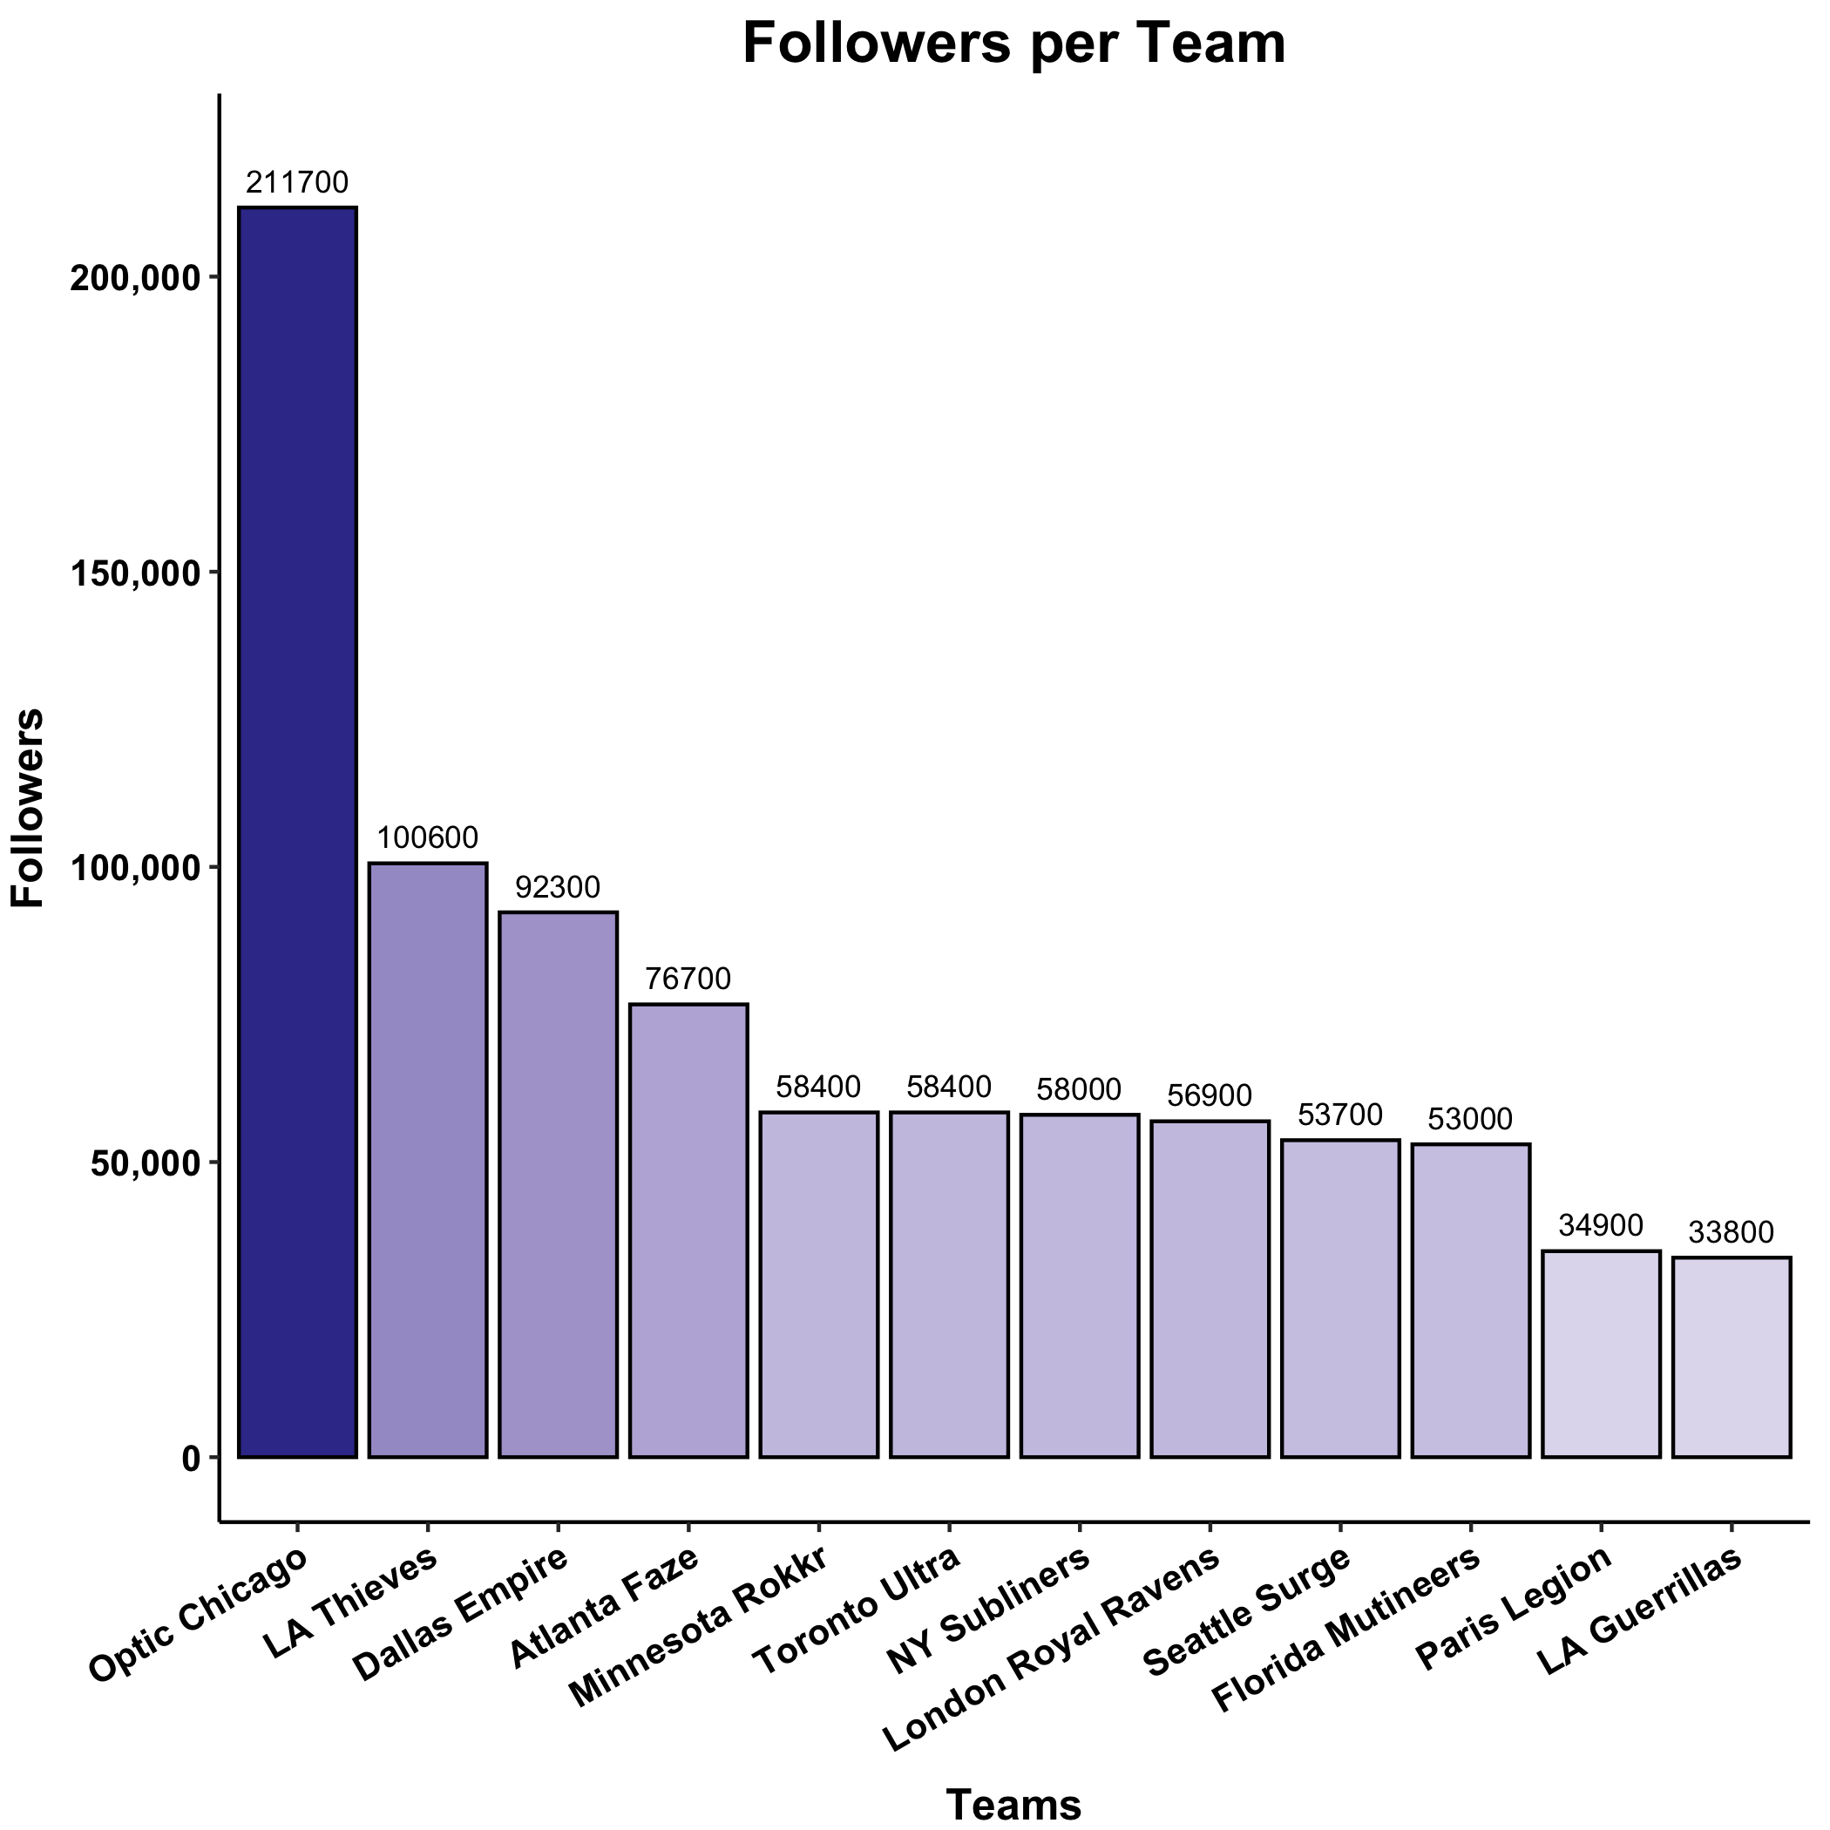







Data Overview
3,600 followers
per team
Data Overview

Slide 5

Data Overview
10 tweets
per follower
3,600 followers
per team
SRS of 50%
56,000 tweets
112,000 tweets
Data Overview

Slide 6




Text Processing
56,000 tweets
CDL
Modern Warfare
CoD
2020
Guerillas
Call of Duty
gg
6,800 tweets
Data Processing

Slide 7


Text Processing
RT @DadJokes: Why don't eggs 🥚 tell jokes? They'd crack each other up! 😂
Remove URLs, RT, Usernames, Punctuation, Numbers
Substitute Emojis with Words
Make Lower Case
Remove Stop Words
eggs jokes crack laughing
Data Processing

Slide 8

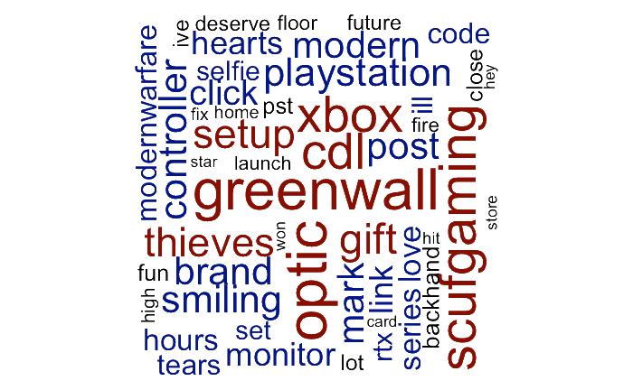
Text Mining Approach: Bag of Words
Data Processing

Slide 9


Findings

Slide 10
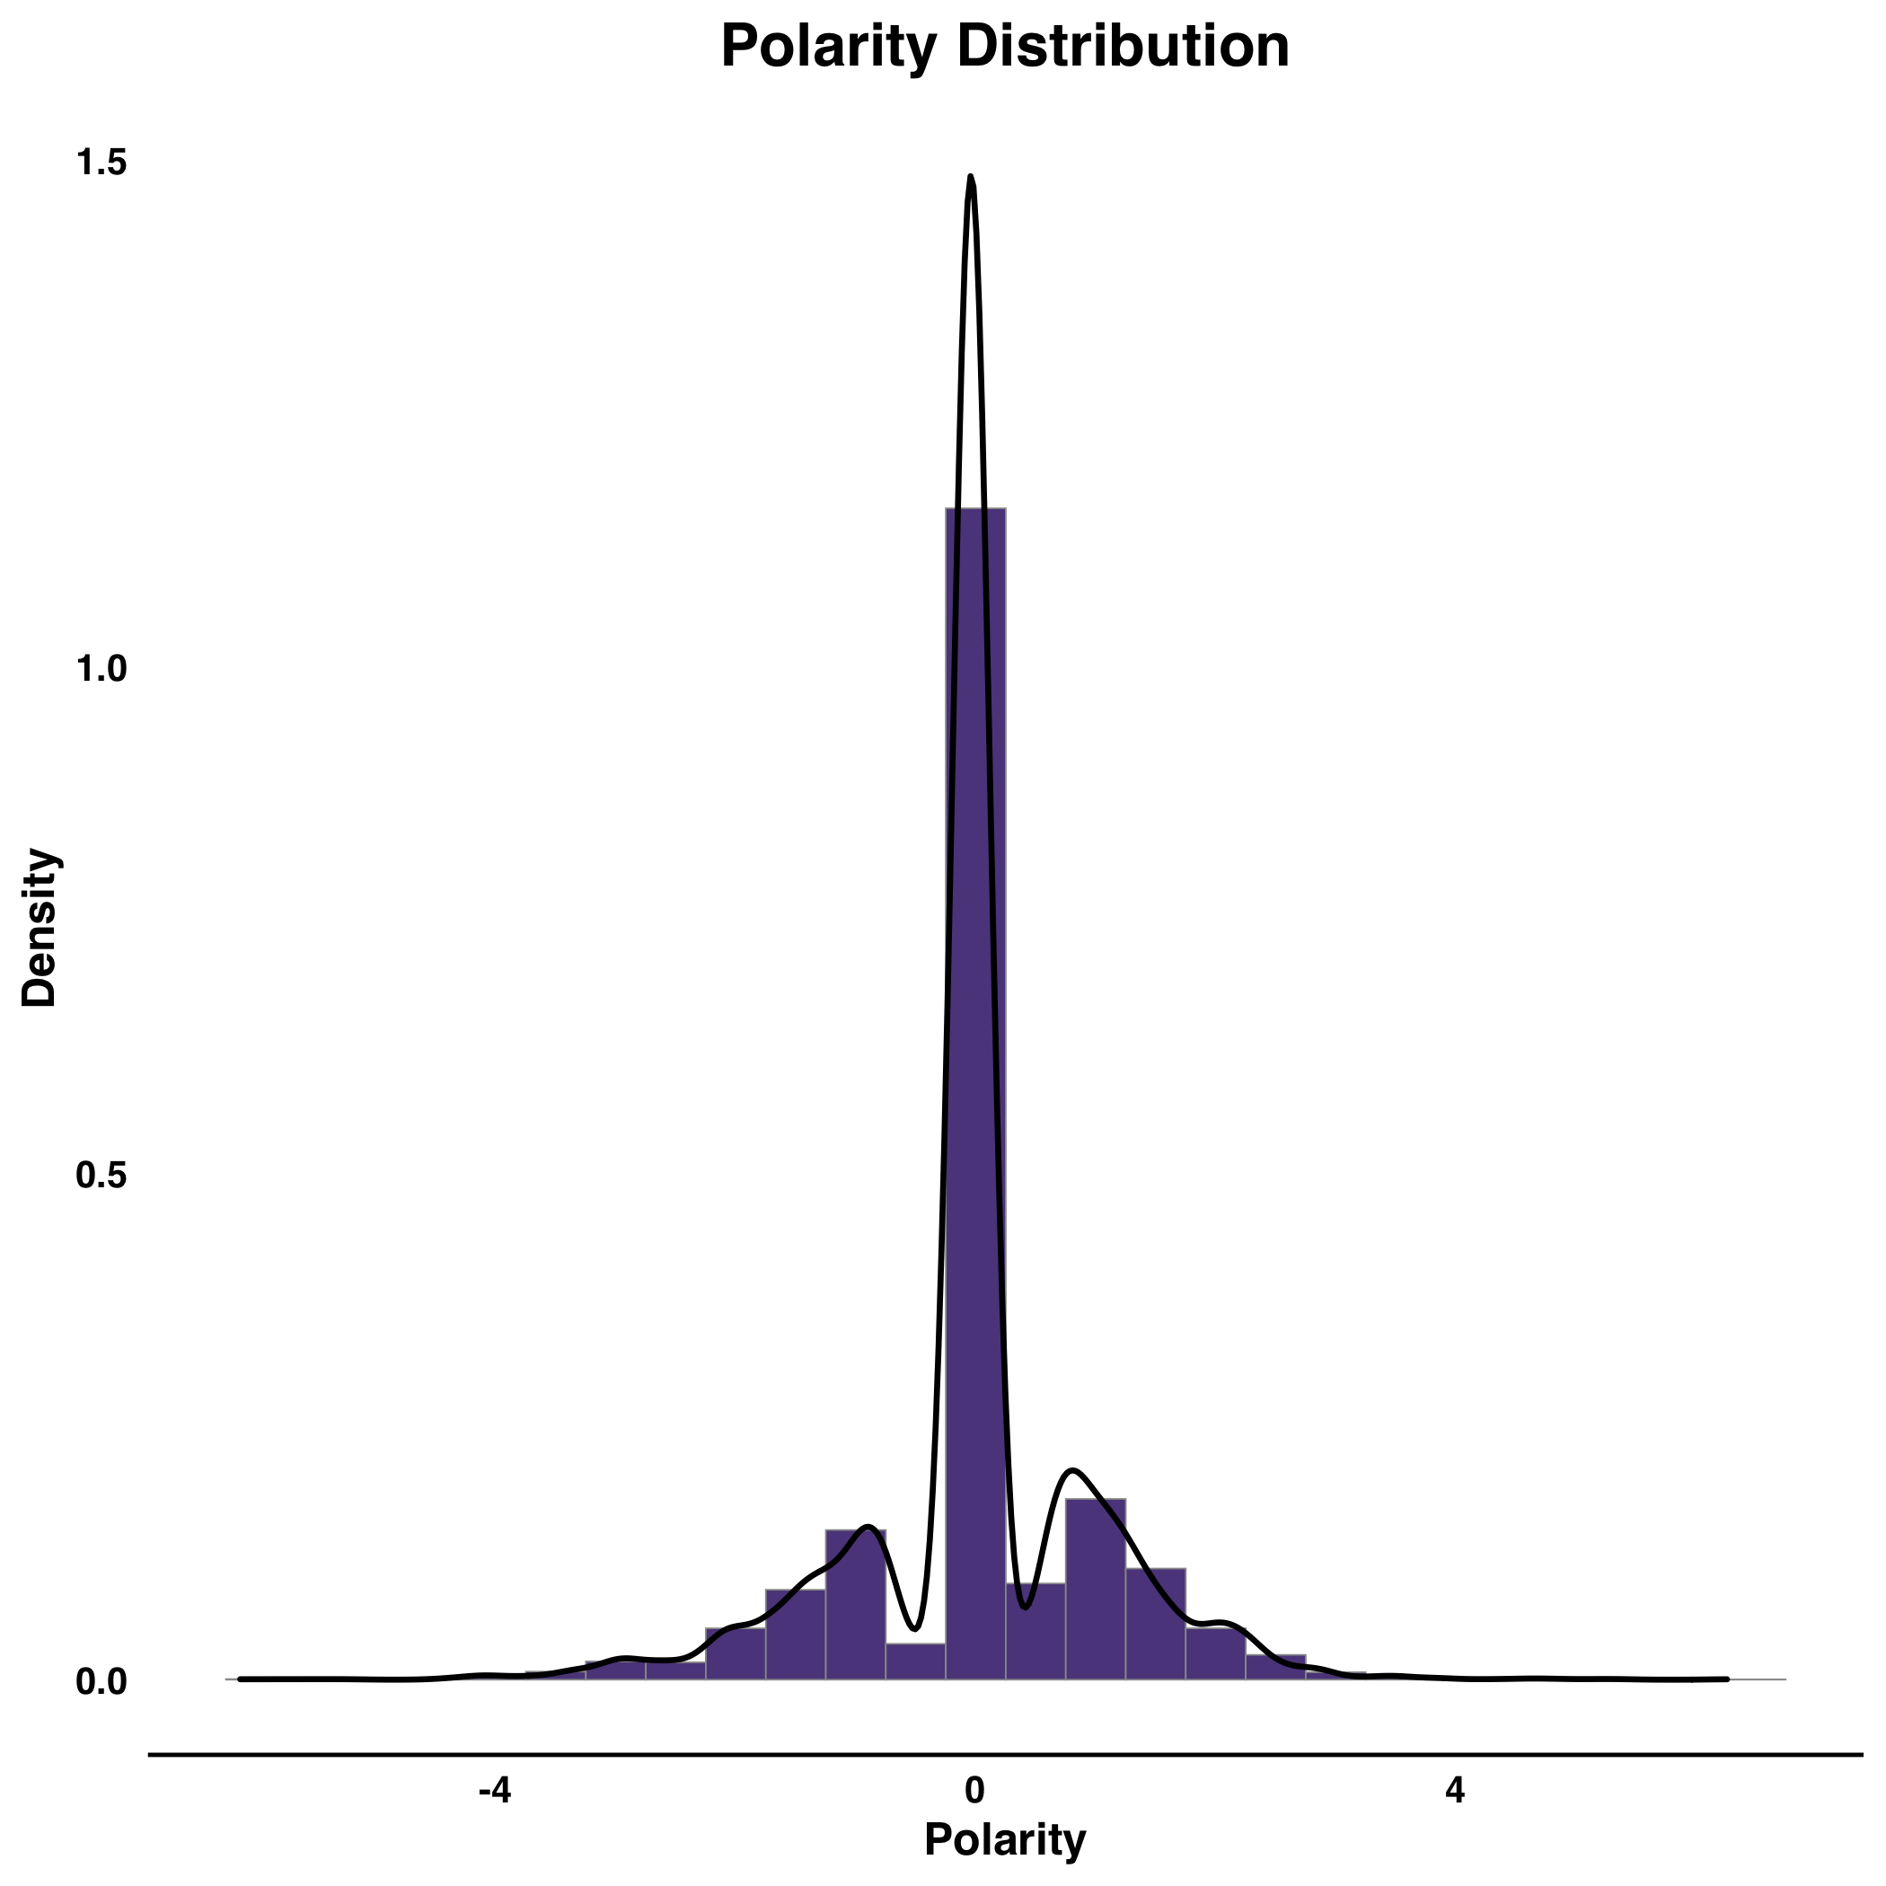
General Polarity
Findings

Slide 11
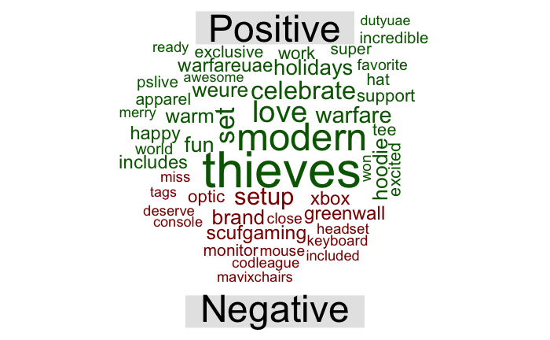
Findings

Slide 12
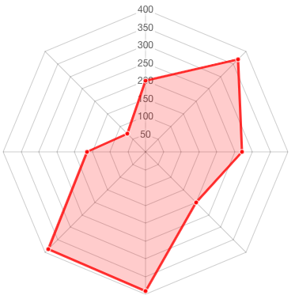
General Sentiment
Anger
Trust
Anticipation
Surprise
Disgust
Sadness
Fear
Joy
Findings

Slide 13
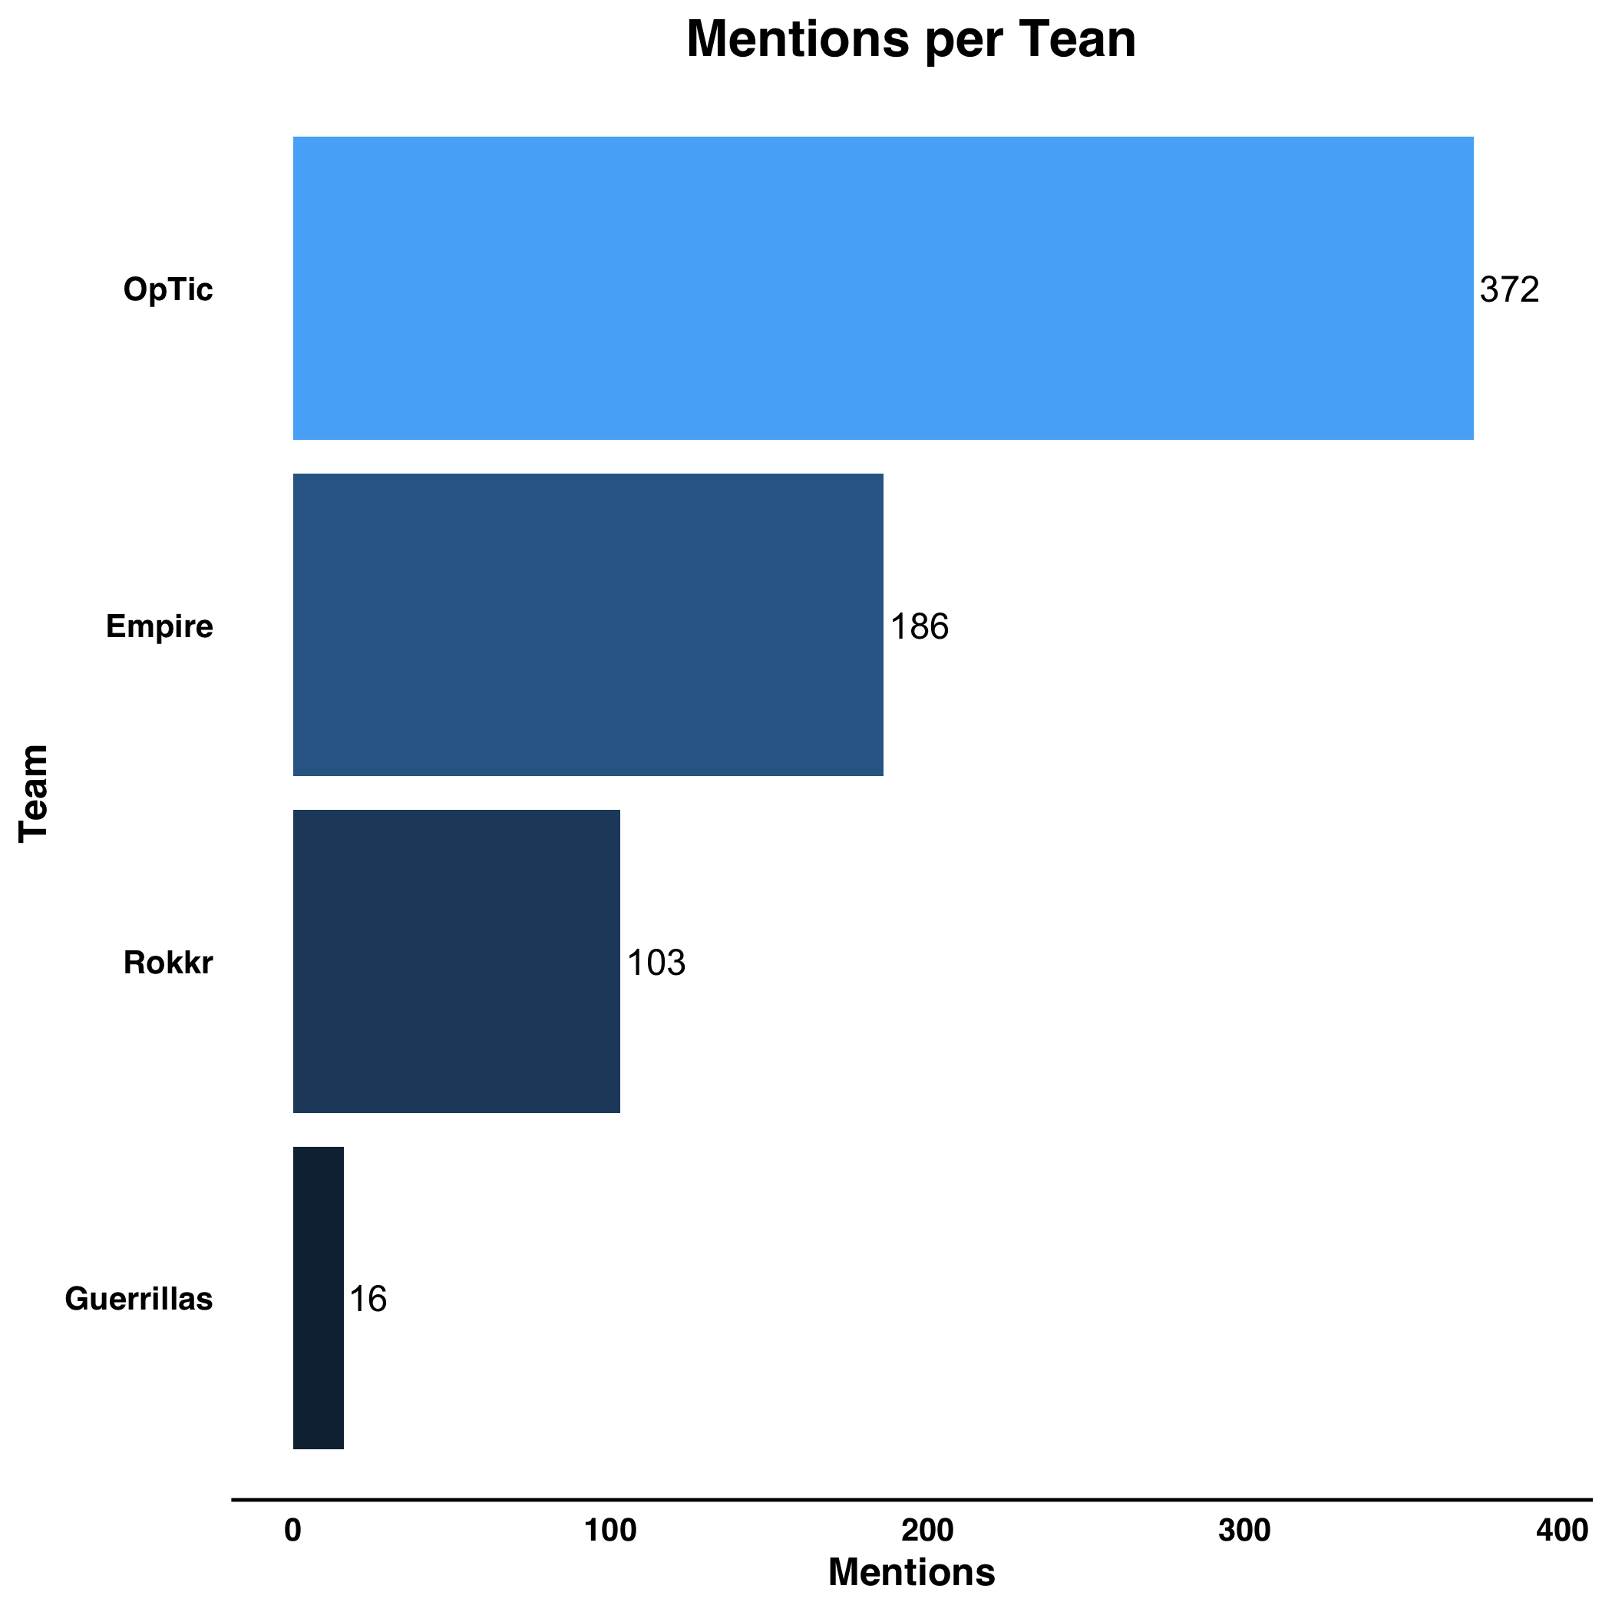
Frequencies
Findings

Slide 14
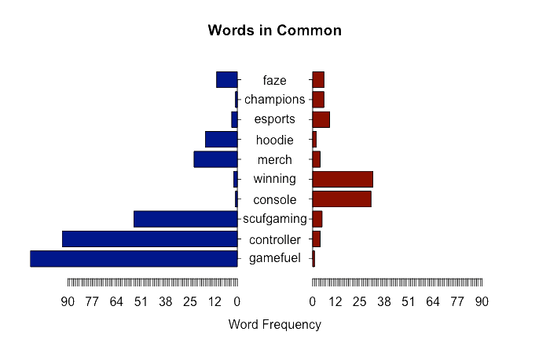

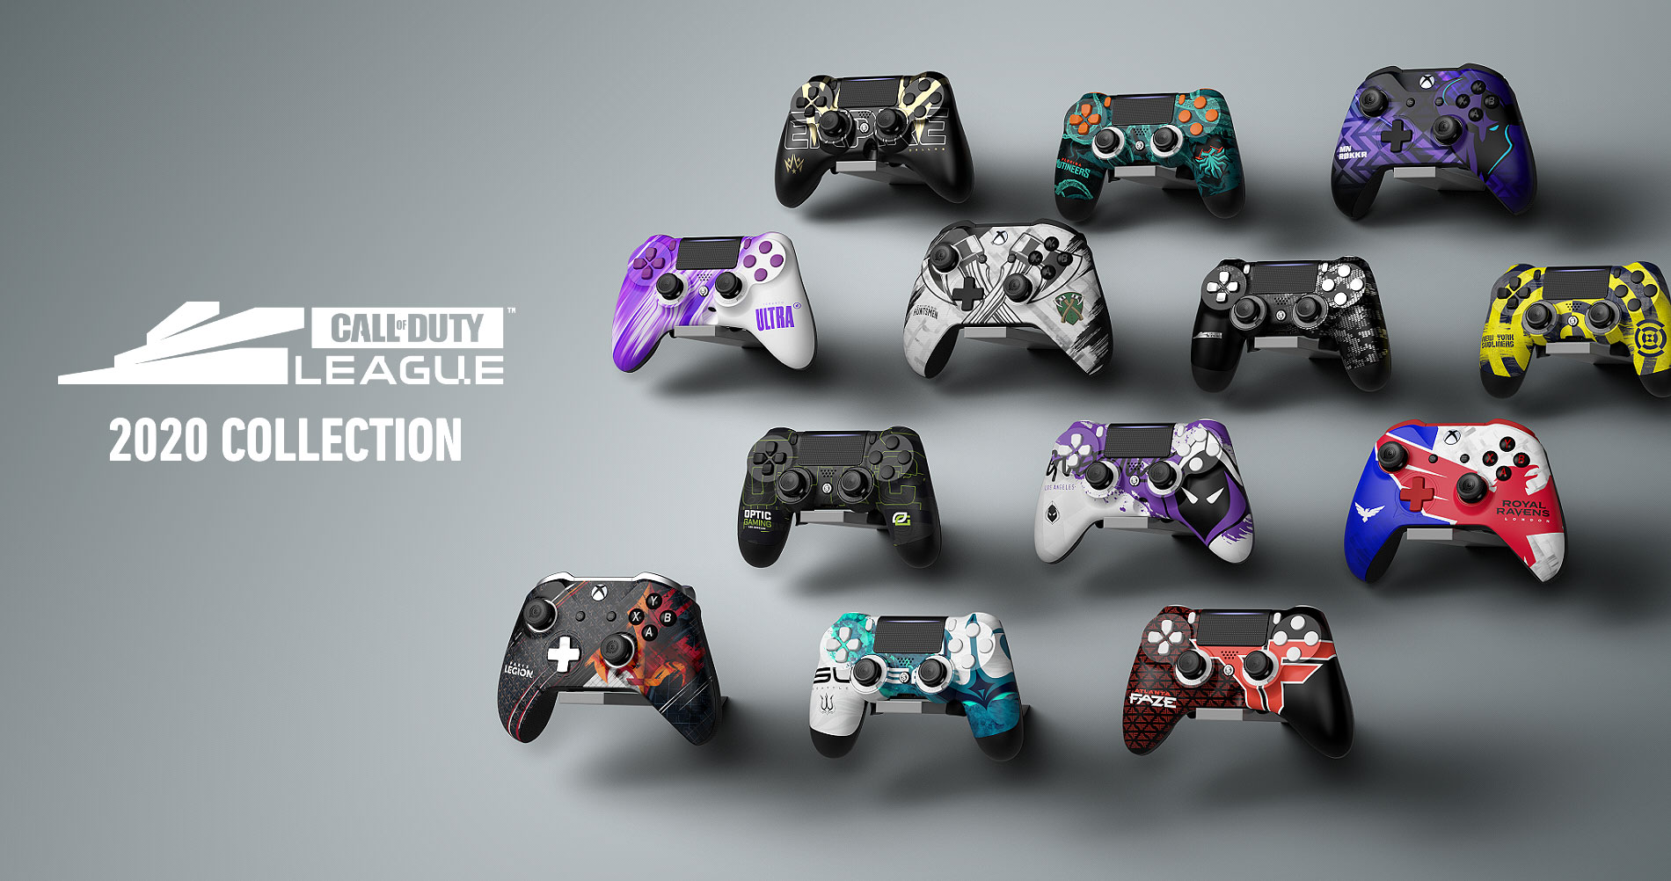


Frequencies
Findings

Slide 15
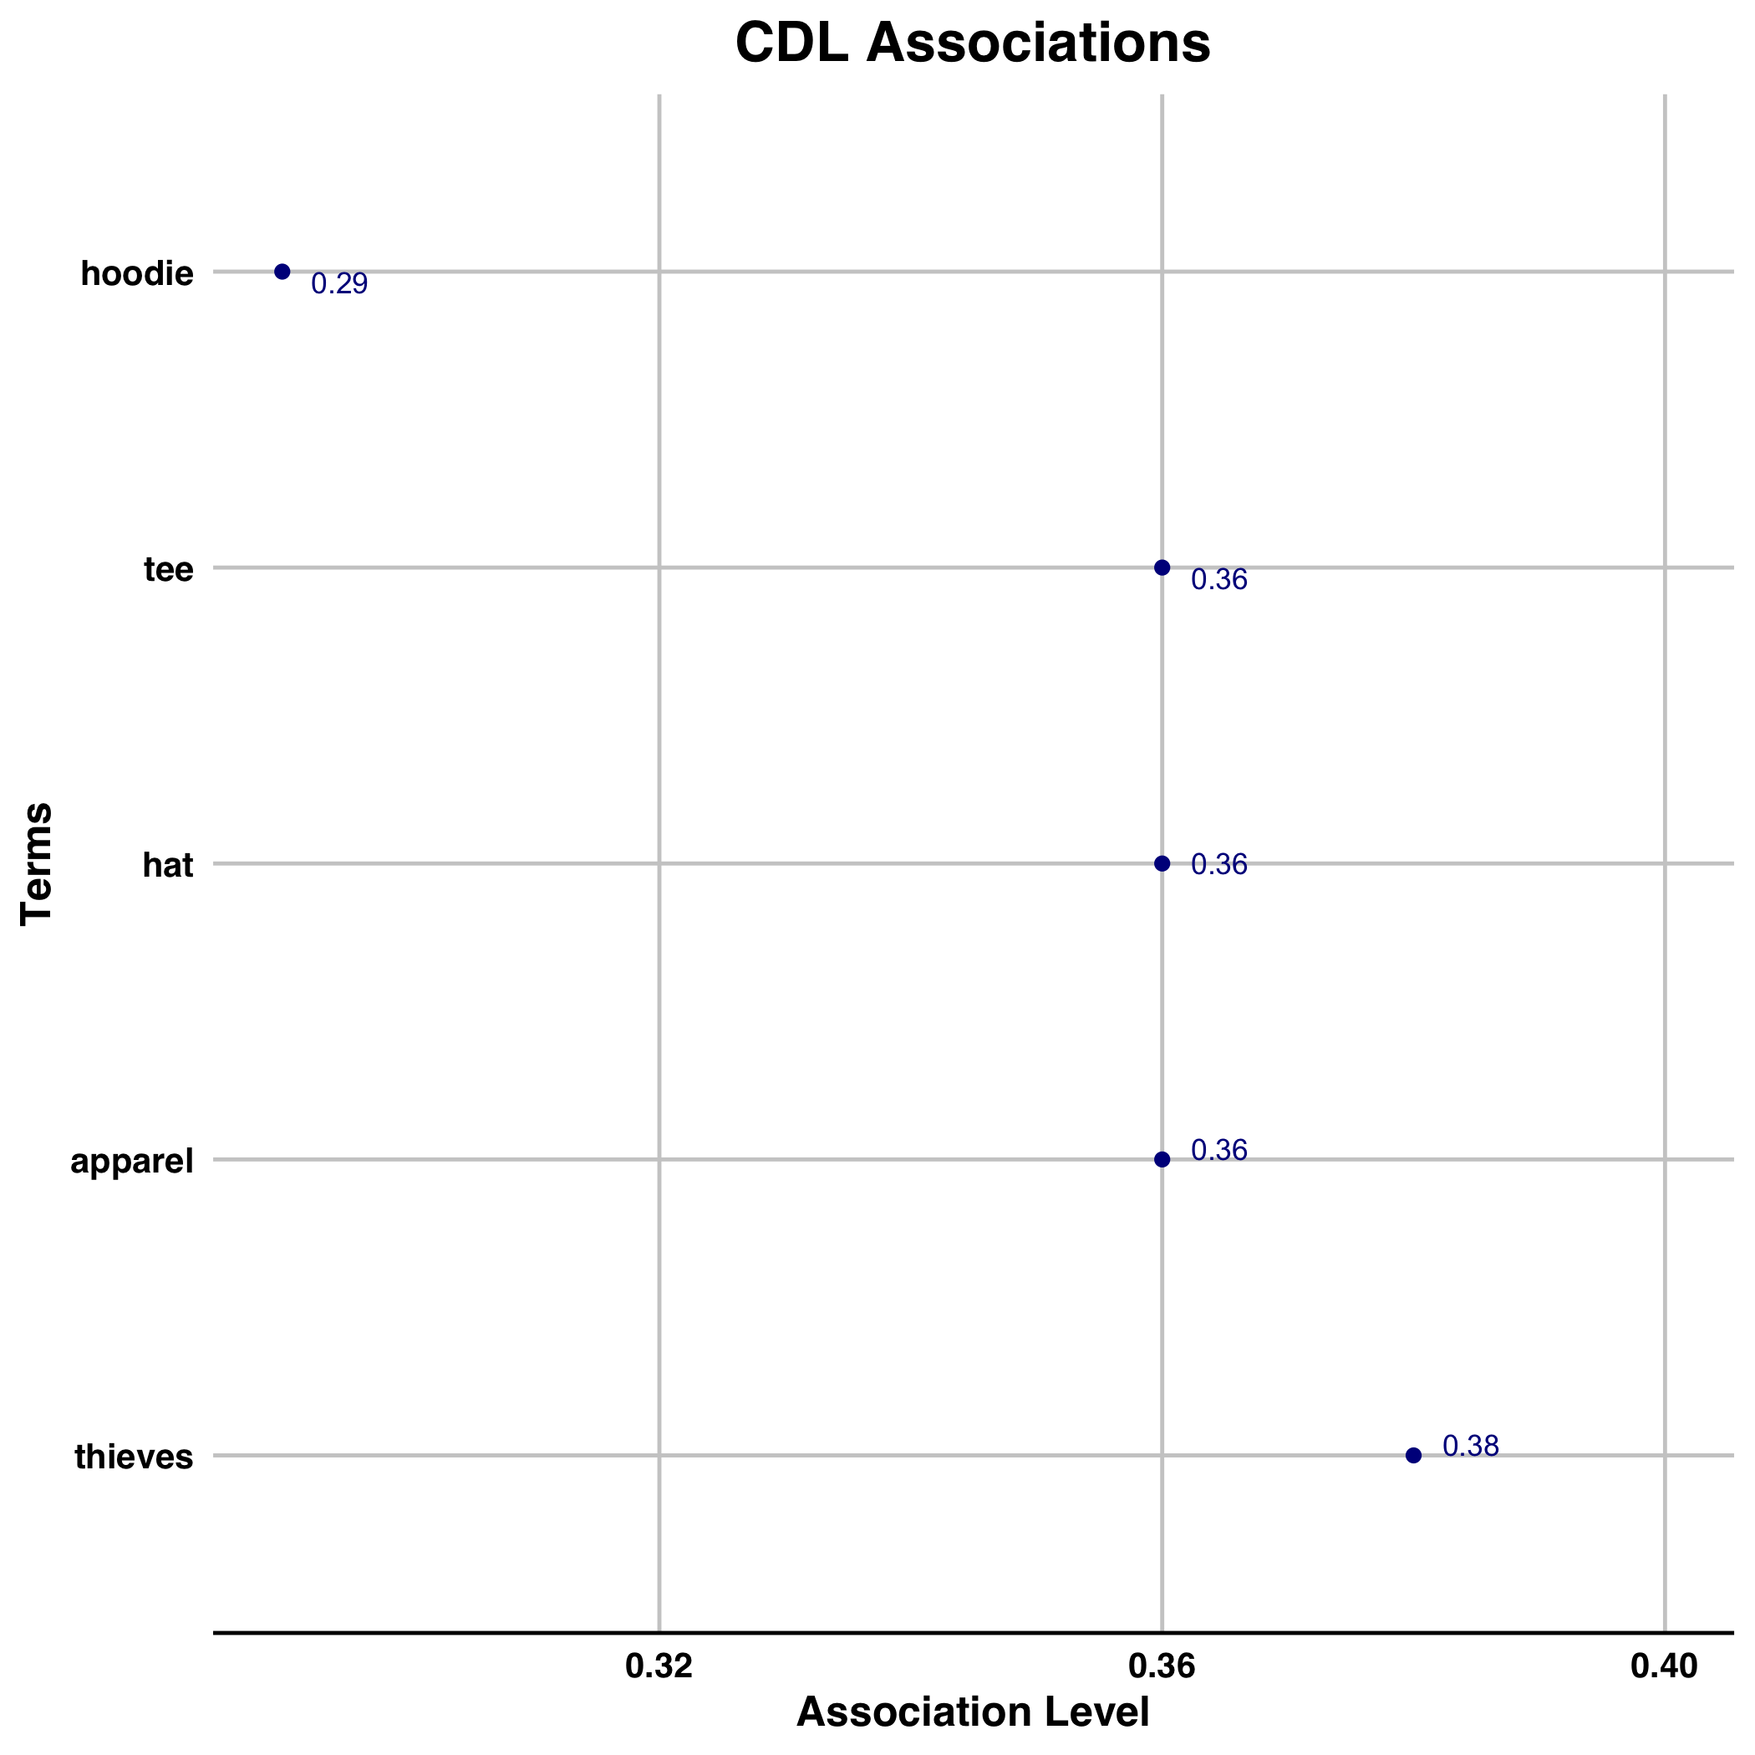
Associations
Findings

Slide 16
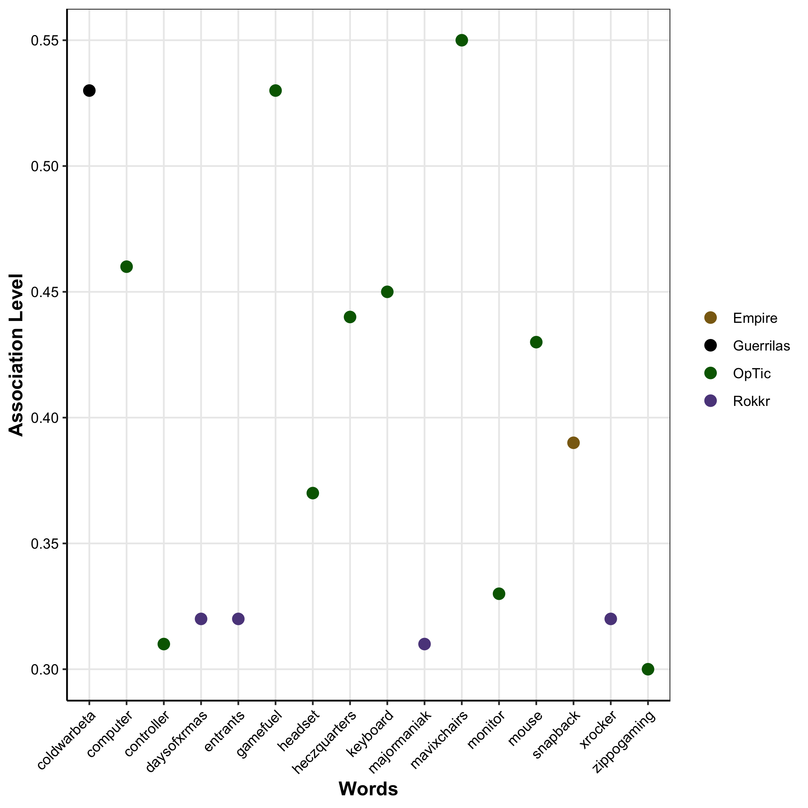
Findings

Slide 17






Recommendations
How can we increase CDL’s reach?
Partner with Scuf Gaming for a CDL edition controller for Xbox & PS
Partner with peripheral manufacturers (e.g. Astro) for CDL edition products (e.g. Headsets)
Increase influencer marketing with teams in order to increase CDL’s reach (e.g. Gamefuel)

Slide 18
Text Mining
Thank You
By Jack Daoud

